Slide 1
Mapping Data to a High-Dimensional Space
Find function Φ(x) to map to a different space, then SVM formulation becomes:
Data appear as Φ(x), weights w are now weights in the new space
Explicit mapping expensive if Φ(x) is very high dimensional
Solving the problem without explicitly mapping the data is desirable

Slide 2
The Dual of the SVM Formulation
Original SVM formulation
n inequality constraints
n positivity constraints
n number of ξ variables
The dual of this problem
n positivity constraints
one equality constraint
n number of α variables (Lagrange multipliers)
Objective function more complicated
Data only appear as Φ(x_{i}) ⋅ Φ(x_{j})

Slide 3
The Kernel Trick
Φ(x_{i}) ⋅ Φ(x_{j}): means, map data into new space, then take the inner product of the new vectors
We can find a function such that: K(x_{i} ⋅ x_{j}) = Φ(x_{i}) ⋅ Φ(x_{j}), i.e., the image of the inner product of the data is the inner product of the images of the data
Then, we do not need to explicitly map the data into the high-dimensional space to solve the optimization problem (for training)
Example 1:x, y points in 2D input, 3D feature space

Slide 4
The linear classifier relies on dot product between vectors K(x_{i},x_{j})=x_{i}^{T}x_{j}
If every data point is mapped into high-dimensional space via some transformation Φ: x → φ(x), the dot product becomes:
K(x_{i},x_{j})= φ(x_{i}) ^{T}φ(x_{j})
A kernel function is some function that corresponds to an inner product in some expanded feature space.
Example 2:
2-dimensional vectors x=[x₁ x₂]; let K(x_{i},x_{j})=(1 + x_{i}^{T}x_{j})²,
Need to show that K(x_{i},x_{j})= φ(x_{i}) ^{T}φ(x_{j}):
K(x_{i},x_{j})=(1 + x_{i}^{T}x_{j})²,
= 1+ x_{i1}²x_{j1}² + 2 x_{i1}x_{j1} x_{i2}x_{j2}+ x_{i2}²x_{j2}² + 2x_{i1}x_{j1} + 2x_{i2}x_{j2}
= [1 x_{i1}² √2 x_{i1}x_{i2} x_{i2}² √2x_{i1} √2x_{i2}]^{T} [1 x_{j1}² √2 x_{j1}x_{j2} x_{j2}² √2x_{j1} √2x_{j2}]
= φ(x_{i}) ^{T}φ(x_{j}), where φ(x) = [1 x₁² √2 x₁x₂ x₂² √2x₁ √2x₂]

Slide 5
Examples of Kernel Functions
Linear: K(x_{i},x_{j})= x_{i} ^{T}x_{j}
Polynomial of power p: K(x_{i},x_{j})= (1+ x_{i} ^{T}x_{j})^{p}
Gaussian (radial-basis function network):
Sigmoid: K(x_{i},x_{j})= tanh(β₀x_{i} ^{T}x_{j} + β₁)

Slide 6
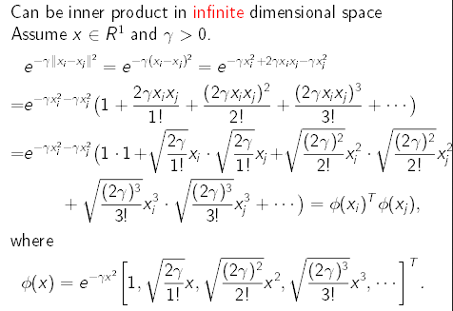

Slide 7
The Mercer Condition
Is there a mapping Φ(x) for any symmetric function K(x,z)? No
The SVM dual formulation requires calculation K(x_{i} , x_{j}) for each pair of training instances. The array Gij = K(x_{i} , x_{j}) is called the Gram matrix
There is a feature space Φ(x) when the Kernel is such that G is always semi-positive definite (Mercer condition)

Slide 8
What Functions are Kernels?
For some functions K(x_{i},x_{j}) checking that
K(x_{i},x_{j})= φ(x_{i}) ^{T}φ(x_{j}) can be cumbersome.
Mercer’s theorem:
Every semi-positive definite symmetric function is a kernel
Semi-positive definite symmetric functions correspond to a semi-positive definite symmetric Gram matrix:
K(x₁,x₁) | K(x₁,x₂) | K(x₁,x₃) | … | K(x₁,x_{N})
K(x₂,x₁) | K(x₂,x₂) | K(x₂,x₃) |  | K(x₂,x_{N})
… | … | … | … | …
K(x_{N},x₁) | K(x_{N},x₂) | K(x_{N},x₃) | … | K(x_{N},x_{N})
K=
Contains all necessary information for the learning algorithm

Slide 9
Making new kernels from the old
New kernels can be made from valid kernels by allowed operations e.g. addition, multiplication and rescaling of kernels gives a proper kernel as long as the resulting Gram matrix is positive definite.
Also, given a real-valued function f(x) over inputs x, then the following is a valid kernel

Slide 11
XOR Problem
K(x_{i},x_{j})=(1 + x_{i}^{T}x_{j})²,
Input vector
X= (x1,x2)
Class label
Y={1, -1}
(1, 1)
(1, -1)
(-1, 1)
(-1, -1)
-1
1
1
-1
K11=(1+[-1 -1]*[-1 -1]')^2
K11 = 9
K12=(1+[-1 -1]*[-1 1]')^2
K12 = 1

Slide 12
Notice that in the dual problem the image of input vectors only involved as an inner product meaning that the optimisation can be performed in the (lower dimensional) input space and that the inner product can be replaced by an inner-product kernel
Q(a) = Σ a_{i} – ½ Σ Σ a_{i} a_{j} d_{i} d_{j} φ(x_{i}) ^{T} φ(x_{j})
= Σ a_{i} – ½ Σ Σ a_{i} a_{j} d_{i} d_{j} Κ(x_{i}, x_{j})
=a₁ +a₂ +a₃ +a₄ – ½(9 a₁ a₁ - 2a₁ a₂ -2 a₁ a₃ +2a₁ a₄
+9a₂ a₂ + 2a₂ a₃ -2a₂ a₄ +9a₃ a₃ -2a₃ a₄ +9 a₄ a₄ )
1 = 9 a₁ - a₂ - a₃ + a₄
1 = -a₁ + 9 a₂ + a₃ - a₄
1 = -a₁ + a₂ + 9 a₃ - a₄
1 = a₁ - a₂ - a₃ + 9 a₄ a1 = a2 = a3 = a4 = 1/8 all the four are support vectors

Slide 13
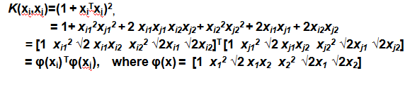
w₀ = Σ a_{0,i} d_{i} φ(x_{i})
= 1/8[-φ(x₁)+ φ(x₂)+ φ(x₃)- φ(x₄)]

Slide 15
The optimal hyper plane is defined by the equation
Similarly find out the other three terms and add. Except terms, all other terms will be canceling each other. You will be getting the same answer

